Slide 1
Soft Skills For Engineers

Slide 2
Case Study
What is Talking the Walk?
In an office, consider you spend a great deal of time developing resources to help employees in your organization make good decisions when they face ethics & compliance challenges.
In that same spirit, your organization wants to provide you a resource to help you and your staff consider the challenges that YOU face as professionals.
Think of this as a regular opportunity for the professional development of your team.

Slide 3
Case Study
Who Cares?
Eva’s been waiting for feedback on a major project. CEO Jamal wants to find the time to respond thoughtfully, but never has a moment to spare. Amanda is being squeezed by the needs of her reports, including Eva, and her boss, Jamal.
Everyone wants things to work better, for everyone to be happier and feel valued, but no one quite knows how. What’s an ethics and compliance team to do?

Slide 4
A Few More Case Studies
https://www.eleapsoftware.com/the-case-for-soft-skills-training-and-best-practices-for-delivery/
https://virtualspeech.com/blog/importance-soft-skills

Slide 5
Why Soft Skills? (Gaps)
Why Do you need Soft Skills at Workplace?
Are you really good at getting clients, and not so good at retaining them?
Do you have lots of staff turnover and still find it difficult to retrain people?
Do you have lots of managers but no real leaders?

Slide 6
Why Soft Skills? (Gaps)
High
Conceptual Age
(creators and empathizers)
Information Age
Affluence
Technology
Globalization
Abundance
Automation
Asia
(knowledge workers)
Industrial Age
(factory workers)
Agricultural Age
(farmers)
Dan Pink
A Whole New Mind
Low
18th Century
19th Century
20th Century
21st Century

Slide 7
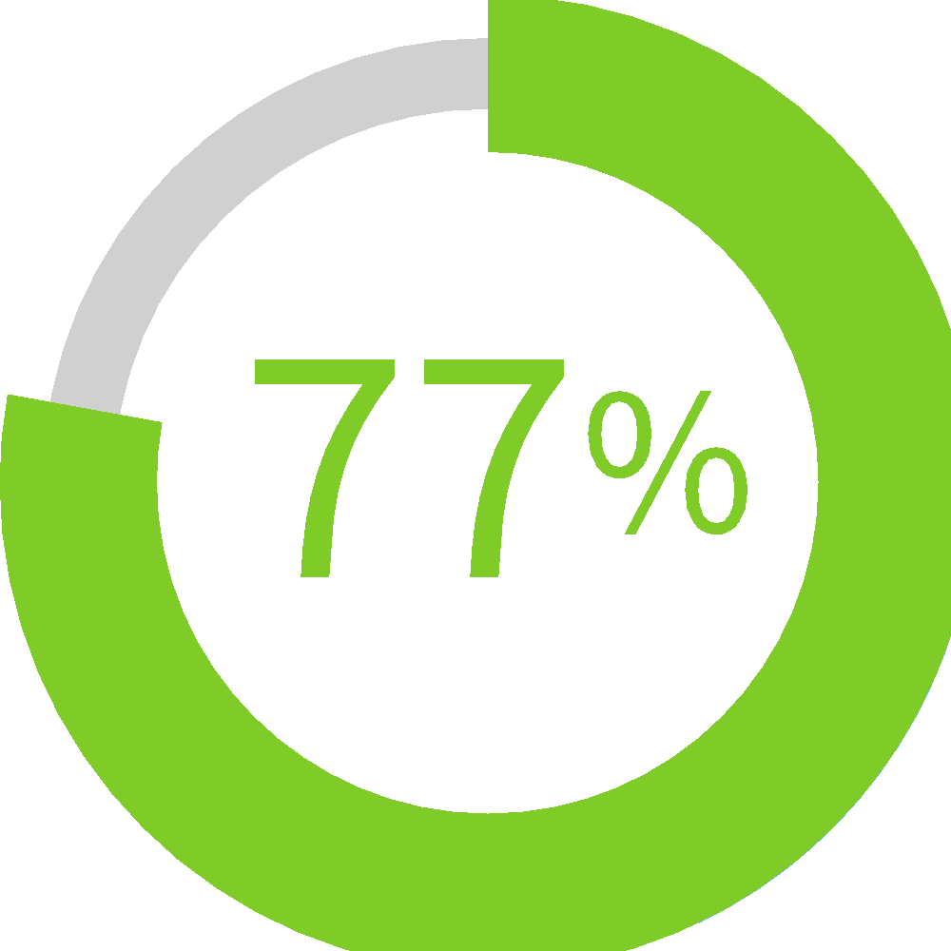
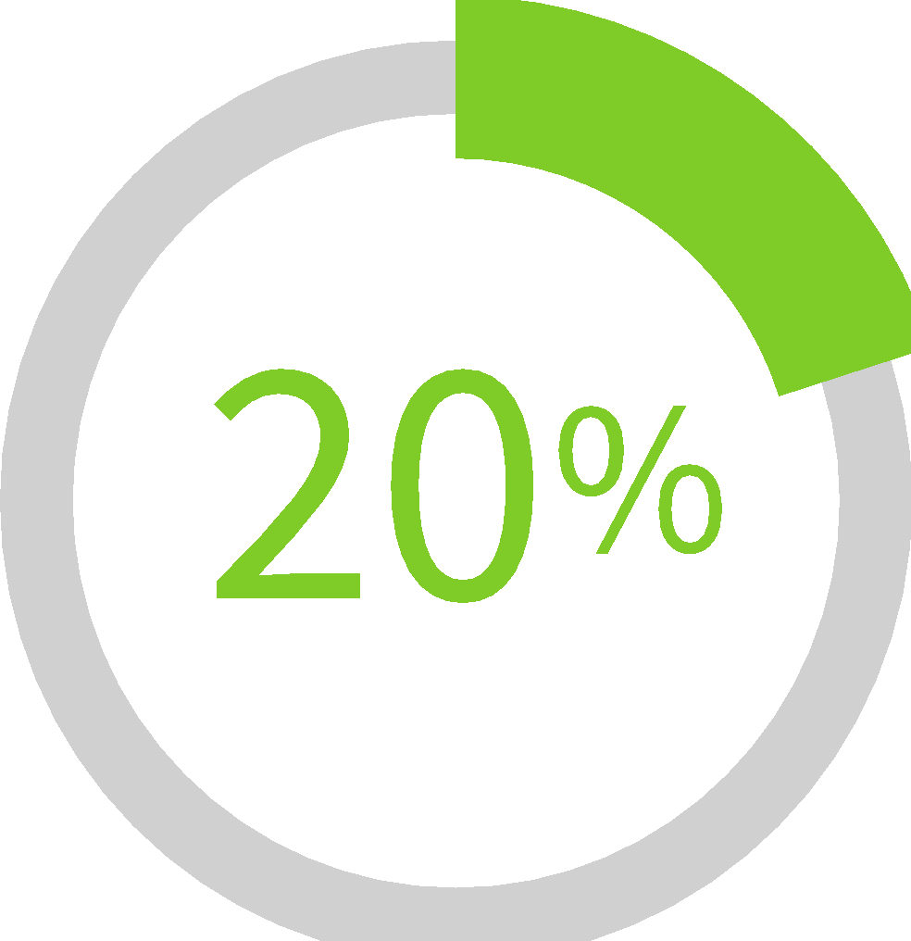
Why Soft Skills? (Gaps)
According to CareerBuilder
77% of employers believe that soft skills are just as important as hard skills.
Almost 20% said they were more important than hard skills.

Slide 8
Seeking Soft Skills
Industry requirement
E.g. Strong communication skills
time-management
Increased productivity
Improved teamwork
Improved retention rates
63% of UK employees would change their employer having more training opportunities
Improved employee satisfaction
Improves leadership
50% of employees leave their job due to poor managers.
Attracts new clients

Slide 9
Soft Skills Training – Reality Check
Speaking in a team meeting or presenting from sales pitches to internal strategy discussions
Good presentation and public speaking skills are key to doing well in today’s volatile business world.
Having great content is important but that’s just not enough.
It must be packaged and presented in an engaging way to achieve the end objective.
This is where soft skills training comes in handy.
With thorough preparation and practice, you can overcome your nervousness and perform exceptionally well for sure.

Slide 10
Soft Skills Training – Reality Check
To maintain good conduct within the office with the juniors, seniors and fellow colleagues.
Efficiency Healthy Environment
Employee Retention
Confidence Productivity
Rewards Customer
Awareness
Happiness

Slide 11
Soft Skills: An Exceptional Skill set
Burning Glass Technologies
Soft skills — a blend of interpersonal savvy, communication skills, and social intelligence — are in high demand by employers today.
James Winebrake, PhD, and Dean of Rochester Institute of Technology’s College of Liberal Arts
These so-called ‘soft skills’ in fact are some of the most challenging skills that people need to master.
These skills allow people to work effectively in teams, to communicate well, and to think in ways that lead to innovation and creativity.
Author Peggy Klaus
Soft skills get little respect, but they will make or break your career.
Bezon Karter
Intrapersonal and interpersonal behaviours that develop and maximize human performance.

Slide 12
Hard v/s Soft Skills
Hard: What You Know and Soft: How You Act
Soft Skills commonly known as people skills
A combination of various skills which help to succeed in life such as communication skills, personality development, social skills, emotional intelligence, etc.
No specific measurements for evaluating individual’s soft skills like hard skills
Hard skills are measurable, tangible and result oriented, they can be quantified.
Soft skills are not fit in one mould – having a flexible attitude, being empathetic, making small talk, confident conversations – aren’t straightforward.
For career growth and sustainability Soft Skills are important

Slide 13
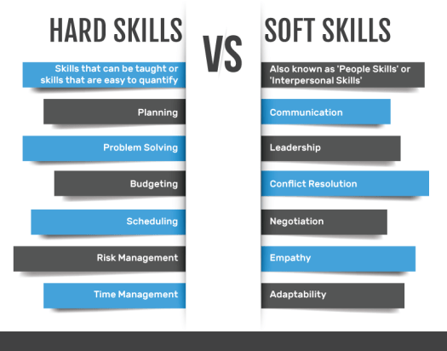

Slide 14
General Soft Skills
Effective Communication
Effective Meetings
Effective Leadership
Conflict Resolution
Problem Solving Strategies
Dealing w/Difficult People
Stress Management
Time Management
Organizational Skills
Presentation Skills
High Performance
Team Building and Managing
Transition & Change

Slide 15
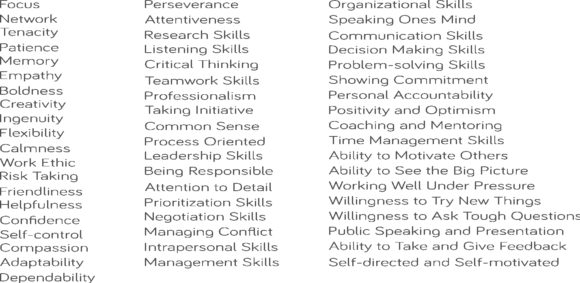
Unending List of Soft Skills

Slide 16
Soft Skills for Competitive Edge
Business Writing Skills
Change Management
Coaching For Performance
Leadership
Negotiation Skills
Powerful Presentations

Slide 17
Soft Skills for Engineers
Communication Skills
Teamwork
Decision making and problem solving skills
Critical thinking
Skills to meet people and crack deals
Interpersonal communication
Easily approachable
Manage customers/ clients across the globe

Slide 18
Hiring Managers Want More
Strong Work Ethic
73%
Flexible
51%
Dependable
73%
Effective Communicator
56%
Positive Attitude
72%
Organized
57%
Team-Oriented
60%
Confident
46%
Works Well Under Pressure
57%
Self Motivated
66%
* Source: CareerBuilder

Slide 19
Resign Yourself to This Reality
46% of newly hired employees will fail within 18 months
89% for lack of soft skills – such as professionalism or ability to get along with others
* Source: “Hire for Attitude” Forbes, January 23, 2012 † Source: “Hiring for attitude: Research & tools to skyrocket your success rate” Mark Murphy, Leadership IQ, 2012

Slide 20

Hiring Well is Hard
This has probably been heard by you before…
Person appears perfect…
dressed well
great answers
a sense of confidence
The interviewer hires him in the organization ….
…and he poisons it

Slide 21
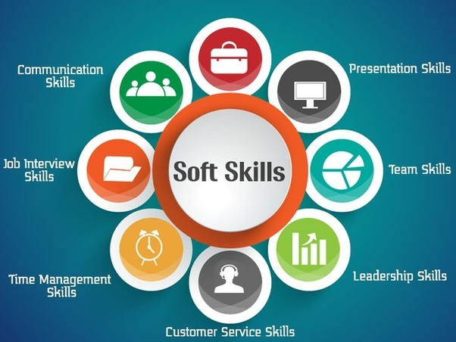
Bottom Line
Soft Skills do matter in career and for sustainability for being an employee or employer

Slide 22


